Slide 1
CIS 581: Face Replacement
En Hui Zou | Adnan Jafferjee | Daniel Harris

Slide 2
Introduction
Goal: Seamlessly swap faces between two videos while maintaining color consistencies and preserving facial expressions.

Slide 3
Methodology
Detect facial landmarks using dlib
Use convex hull from OpenCV to align faces
Delaunay triangulation of convex hull points
Affine transformation for each triangle
Seamless cloning using OpenCV

Slide 4
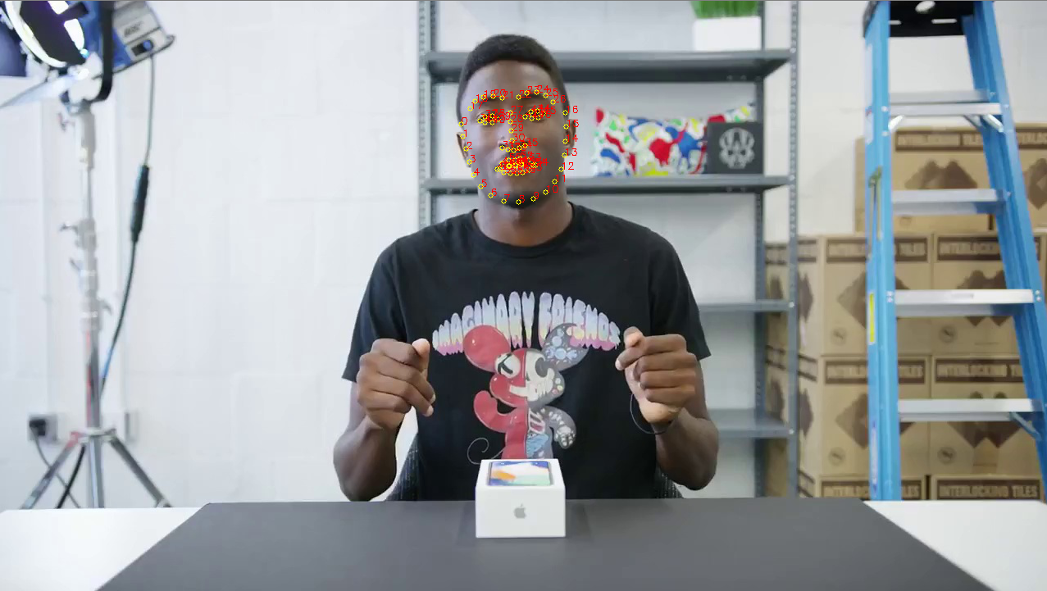
Results: Feature Detection

Slide 5
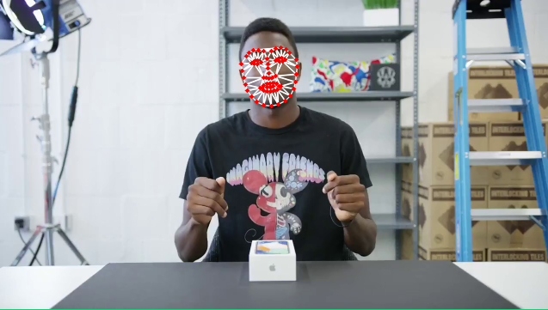
Results: Delaunay Triangulation

Slide 6

Results: Mask

Slide 7
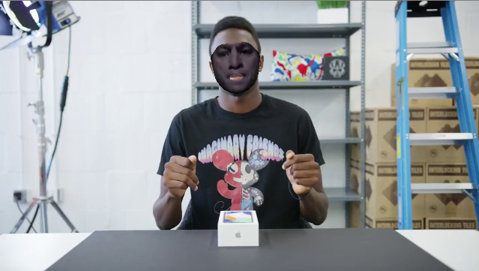
Results: Face Swap

Slide 8
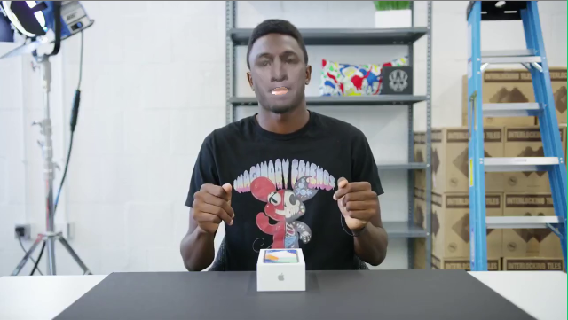
Results: Seamless Cloning using Poisson Blending

Slide 9
Results: Face Swapping

Slide 10
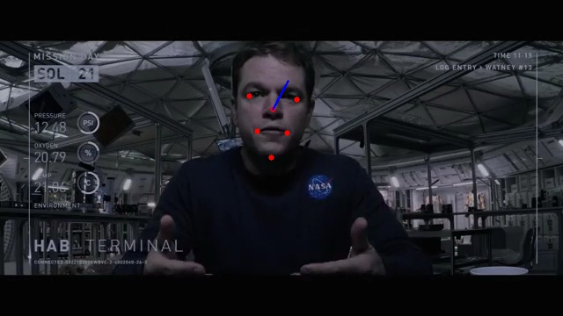
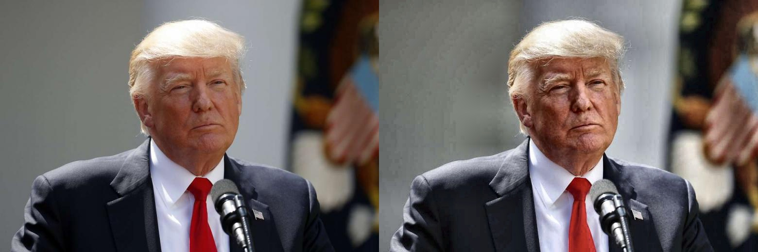
Analysis/ Future Work
Implement alignment of faces for changing head orientation
Contrast-limited Adaptive Histogram Equalization

Slide 11
References
dlib C Library. [Online]. Available: http://dlib.net/face_detector.py.html. [Accessed: 17-Dec-2017].
S. Mallick, “Home,” Learn OpenCV, 05-Apr-2016. [Online]. Available: https://www.learnopencv.com/face-swap-using-opencv-c-python/. [Accessed: 17-Dec-2017].
V. Kazemi and J. Sullivan, “One millisecond face alignment with an ensemble of regression trees,” 2014 IEEE Conference on Computer Vision and Pattern Recognition, 2014.

Slide 12
Google slide link to PPT:
https://docs.google.com/presentation/d/e/2PACX-1vSfYDkE1YHWJeN3U8V5cSPNEOYB9Qq2pqyEAIQkYWC6UE2xIBYTeRp9q74FyXfaQGmLxjKbLxYnwDbi/pub?start=false&loop=false&delayms=3000

